Slide 1

THE ANGEL HOUSE ACADEMY
Save the Teens
Building the next generation of founders — a gamified journey from school into entrepreneurial life.
A_H_A

Slide 2

THE WHY
01
SECTION 01
THE WHY
A_H_A

Slide 3
THE WHY
02
Traditional education taught in schools has a MEANINGFUL PLACE in a child’s upbringing.
A_H_A

Slide 4
THE WHY
03
However, today’s schooling methods and content FACE LIMITATIONS and are INCOMPLETE.
A_H_A

Slide 5
THE WHY
04
Only PRIVATE schools go BEYOND the traditional teaching curriculum to include real WORLD BUSINESS SKILLS.
A_H_A

Slide 6
THE WHY
05
These skills are essential for FUTURE DECISION making and CAREER CHOICES.
A_H_A

Slide 7
THE WHY
06
Teaching methods and school content have remained RIGID for decades — if not centuries — while the world around us is CHANGING at an EXPONENTIAL RATE.
A_H_A

Slide 8
THE WHY
07
School education remains a LEGAL IMPERATIVE in 95% of all jurisdictions, while ‘out-of-school’ education is a PRIVILEGE for THE AFFLUENT.
A_H_A

Slide 9

THE WHY
08
Around the time of high school graduation, teens are at their most potent CROSSROAD in life to SELF DETERMINE their future.
A_H_A

Slide 10
THE WHY
09
This moment of POTENCY exposes a vulnerable decision point where UNCERTAINTY meets RESPONSIBILITY.
A_H_A

Slide 11
THE WHY
10
A moment of potency that can turn into a DILEMMA for those who understand their choices, and a BLACK BOX for those who don’t.
A_H_A

Slide 12
THE WHY
11
Self doubt, lack of guidance and information yield the highest r² to career disorientation and anxiety among teens. LACK OF AMBITION displays the lowest correlation.
A_H_A

Slide 13

THE WHY
12
130M
teenagers worldwide, annually
Come to this pivotal decision making CROSSROAD every single year.
A_H_A

Slide 14

THE WHAT
13
SECTION 02
THE WHAT
A_H_A

Slide 15
THE WHAT
14
Traditional education creates GREAT STUDENTS. We complement this by showing them how to become FOUNDERS.
A_H_A

Slide 16
THE WHAT
15
7% / 90%
launch a business — and most don’t survive
A combined 7% of all 100 million high school graduates annually launch a NEW BUSINESS, of which 90% FAIL within the first few years.
A_H_A

Slide 17
THE WHAT
16
93% of high school graduates chose NOT to launch businesses at first. However, by 2030, 25% of all corporate entry-level jobs will face significant AI SUBSTITUTION RISK.
A_H_A

Slide 18
THE WHAT
17
We capitalize on the GROWING job market UNCERTAINTY for graduates by turning entrepreneurial CURIOSITY into entrepreneurial REALITY. And the time is NOW.
A_H_A

Slide 19
THE WHAT
18
Our goal is to convey a start-up process and share real life experiences to DE-RISK the LAUNCH OF BUSINESSES among graduates.
A_H_A

Slide 20
THE WHAT
19
WE DELIVER THIS THROUGH
The Angel House
Academy
A_H_A
A gamified way of building IP and selecting WINNERS for FUNDING.
A_H_A

Slide 21

THE HOW
20
SECTION 03
THE HOW
A_H_A

Slide 22
THE HOW
21
‘A_H_A’ is a physical and virtual COMMUNITY of meaningful connections that pass on the reality of founding businesses — dedicated to building the NEXT GENERATION OF WEALTH.
A_H_A

Slide 23
THE HOW
22
We inform choices at the beginning of a professional career, in a RISK FREE, CONSTRUCTIVE and FUN environment, among like minded PEERS.
A_H_A

Slide 24

THE HOW
23
We offer GUIDANCE, MENTORSHIP, TUITION, NETWORK access and FUNDING for teens that want to transition from SCHOOL into ENTREPRENEURIAL life.
A_H_A

Slide 25
THE HOW
24
We teach a CURATED JOURNEY from ideation to product launch, followed by global growth leaders and start-ups alike, to DE-RISK your ideas and MAXIMIZE FOR IMPACT.
A_H_A

Slide 26
THE HOW
25
We accompany attendants from CUSTOMER DISCOVERY through to VALIDATION and deeply root your idea in a viable PROBLEM/SOLUTION and SOLUTION/MARKET fit.
A_H_A

Slide 27
THE HOW
26
We will teach, mentor, guide and ENRICH attendants by EXPERIENCES from founders, academics, innovators, investors and coaches — covering all aspects of the start-up journey.
A_H_A

Slide 28
THE HOW
27
GRADUATION OUTCOMES
What attendants leave with
01
An exceptional professional LEARNING experience
02
A NETWORK for life
03
A robust FRAMEWORK to launch businesses
04
The opportunity to PITCH FOR FUNDING to our Investment Committee
A_H_A

Slide 29

THE JOURNEY IN DETAIL
28
SECTION 04
THE JOURNEY
IN DETAIL
A_H_A

Slide 30
THE JOURNEY IN DETAIL
29
We are looking for talent that is CURIOUS, HUNGRY, CONFIDENT, UNDECIDED, HUMBLE and RAW.
A_H_A

Slide 31
THE JOURNEY IN DETAIL
30
We target teenagers in their PENULTIMATE years before graduation (up to 130 million annually worldwide), or who delay an immediate transition to university for a GAP YEAR (up to 35 million annually worldwide).
A_H_A

Slide 32
THE JOURNEY IN DETAIL
31
Applicants will be SELECTED and SCREENED through online interviews for FIT and READINESS.
A_H_A

Slide 33
THE JOURNEY IN DETAIL
32
Success in program progression depends on passing STAGE GATES — appealing to the competitive and gaming nature of teens.
A_H_A

Slide 34
THE JOURNEY IN DETAIL
33
ACQUISITION
How we reach prospects
01
Introduced to the program by Angel House COMMUNITY members who have kids
02
Identified across the Angel House NETWORK, where hosts act as MULTIPLIERS and ambassadors
A_H_A

Slide 35
THE JOURNEY IN DETAIL
34
10,000
kids onboarded — at just 0.01% of all graduates annually
Along the way, the A_H_A builds a significant pipeline of IDEAS, IP, INSIGHT, TRENDS and TALENT.
A_H_A

Slide 36
THE JOURNEY IN DETAIL
35
ONLINE STAGE GATE MISSIONS
From customer discovery to validation
01
IDEATION — customer problem, business model
02
SOLUTION — design prototype, likelihood of acceptance
03
BETA — MVP, willingness to pay
A_H_A

Slide 37
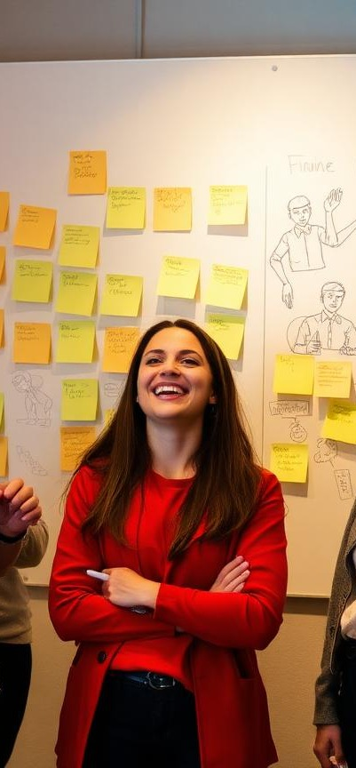
THE JOURNEY IN DETAIL
36
OFFLINE PHYSICAL STAGE GATE MISSION
From customer validation to creation
04
PRODUCT — proven business, fit to scale
The physical summit is a 3-DAY EVENT for the best global peers to meet, co-create, validate, have fun, and get mentored and coached to the FINISH LINE.
A_H_A

Slide 38

THE JOURNEY IN DETAIL
37
The process concludes with the winning academy participants PITCHING their equity story to an INVESTMENT COMMUNITY for further funding and TAKE TO MARKET.
A_H_A

Slide 39

A_H_A
Let’s save the teens.
The Angel House Academy

